Slide 1
Determinant
A square arrangement of elements enclosed by bar or vertical lines is called determinant. Determinant is numeric value attached to a matrix. Determinant always exist for a square matrix. The determinant of a rectangular matrix has no meaning.

Slide 2



Properties of determinant
There are total 10 properties of determinant.
Basic properties of determinant are three and other seven properties can be obtained with the support of these three properties. These three properties are:
The determinant of identity matrix is always 1. That is
2. When we exchange two rows of determinant then we have multiply with minus sign. That is
3.The determinant linearly depends on first row. That is

Slide 3
The other seven properties of determinant can be proved by using these three basic properties. Remember that the determinant of triangular matrix is the product of diagonal entries. The determinant of the product of matrices is equal to the product of their individual determinant. The determinant of a matrix and its transpose is same and so no.

Slide 4
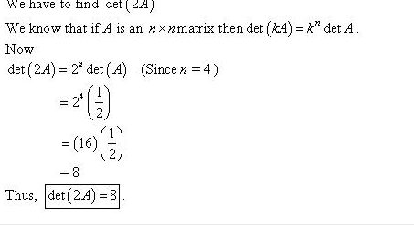
Problem Set 4.2
Question 1:
If a 4 by 4 matrix has detA = 1/2
, find det(2A), det(-A), det(A²), and det(A⁻¹).
Solution:

Slide 5
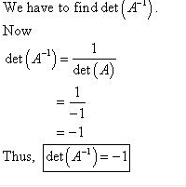
Calculation of det(A⁻¹)
Solution:

Slide 6
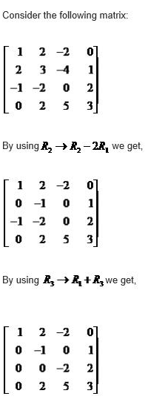
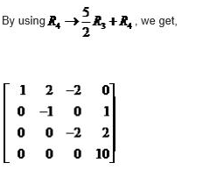
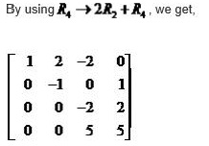
Question No. 4 See statement from the book. I will solve its first part.
Solution.

Slide 7
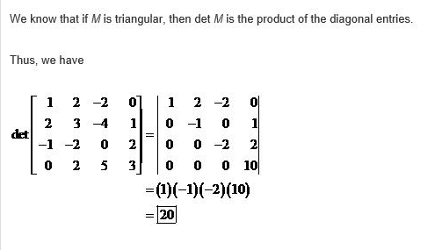
Always remember that the determinant of a triangular matrix is the product of diagonal entries.

Slide 8
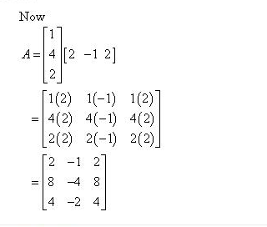
Q.7
1. If we observe A then we we come to know that that this is linearly
dependent matrix and and the determina
nt of LD matrix is
zero. Do other
Parts of this problem by yourself.

Slide 9
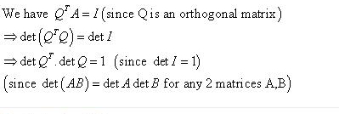
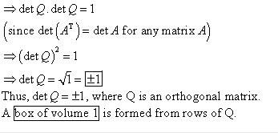
Q10
Solution:

Slide 10
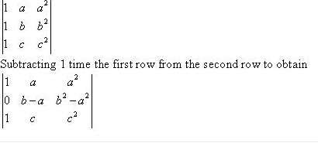
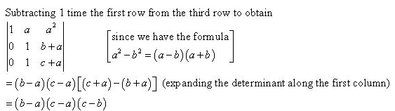
Q12

Slide 11
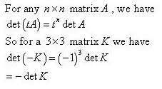

Q13

Slide 12
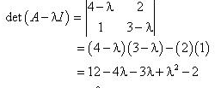
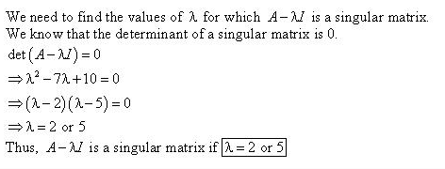
Q.17 (third part)

Slide 13
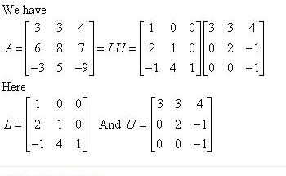



Q25
Solution:

